Slide 1





CompuCell3D Workshop: Module 9.2: C++ extensions
Michael Getz
Dept. of Intelligent Systems Engineering
and Biocomplexity Institute
Indiana University
Bloomington, IN 47408
USA
Thursday, August 7, 2025
Link to Compucell3D Developer manual: https://compucell3ddevelopersmanual.readthedocs.io/en/master/index.html
Hackathon Idea Sharing Documents: https://tinyurl.com/2026TeamingDoc
Please join the workshop Slack: https://tinyurl.com/2026CC3DSLACK
Workshop will be live-streamed, recorded and distributed on YouTube
Funding: NIH U24 EB028887, NSF 2120200, NSF 2000281, NSF 2303695. Previous Funding: NIH R01 GM1224241, NSF 1720625
Notes:
Post slack link repeatedly in Chat Keep links available to repost

Slide 2
Module 9.2 Topics
9.2.1 – What is a steppable and plugin?
9.2.2 – Tweddit plug in creation
9.2.3 – Tweddit shortcuts and IDEs
9.2.4 – Example Steppable: GrowthSteppable
9.2.3 – Example Plugin: SimpleEnergyPenalty

Slide 3

9.2.1 Steppables and plug ins evaluate at different times
Steppables
are modules that the Simulator calls after each MCS (e.g. PDE solvers). These are the same as python steppables, but are evaluated first.
Plug ins
Lattice Monitors - modules that are called each time CC3D functions (e.g. metropolisFast) make a change to the cell lattice.
Energy Function - this module is called every pixel copy attempt because Potts algorithm calls this module to compute its contribution to the overall change of energy due to proposed pixel copy (∆H or ∆E).
What is metropolisFast?
metropolisFast is one of the iterators that CC3D uses
to calculate and attempt the pixel flip attempts
$$P=e^{\frac{−∆H}{T}}$$

Slide 4
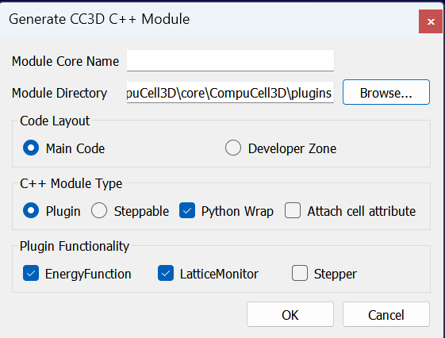
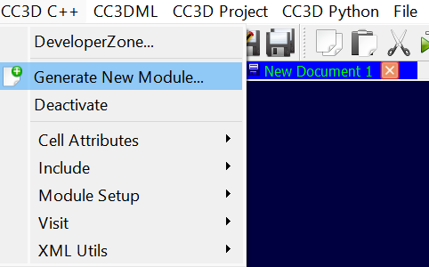
9.2.2 Setting up a plug in from tweddit
You will now see this window:
Editing chemotaxis in XML:
CC3DML➔ CC3D C++➔ Generate New Module…
We will now discuss some of these options

Slide 5
9.2.2 Setting up a module from tweddit
Directory of Module
This is important!
We will discuss this later
Name of Module
Keep main code layout unless you have set up Developer Zone (we have NOT)
Is this a plug in or a steppable?
Plugin specific options

Slide 6
9.2.2 Where to target
For Steppables:
…\CompuCell3D\CompuCell3D\core\CompuCell3D\steppables
For Plugins:
…\CompuCell3D\CompuCell3D\core\CompuCell3D\plugins

Slide 7
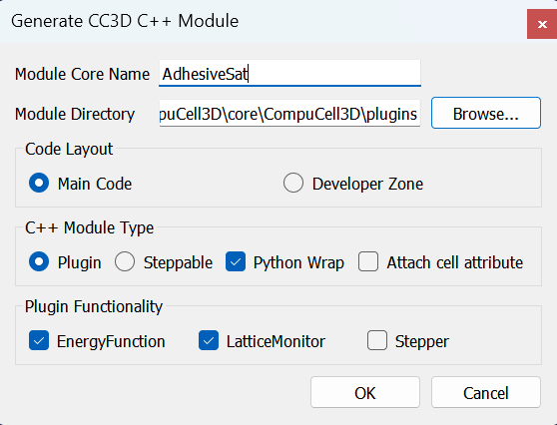
9.2.2 Let us make a plug in
Name
AdhesiveSat
target
…\CompuCell3D\CompuCell3D\core\CompuCell3D\plugins
Select Plugin
Keep Python Wrap checked

Slide 8
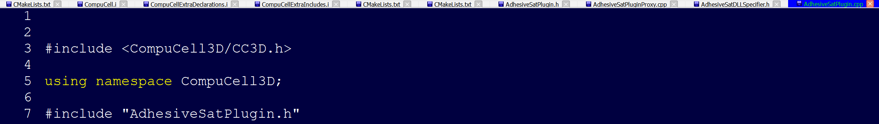
9.2.2 What is created when running
This creates 10 files that will now open in tweddit
You can define how the xml is referenced with the Proxy file and provide a brief description:
We will keep the name as is.

Slide 9
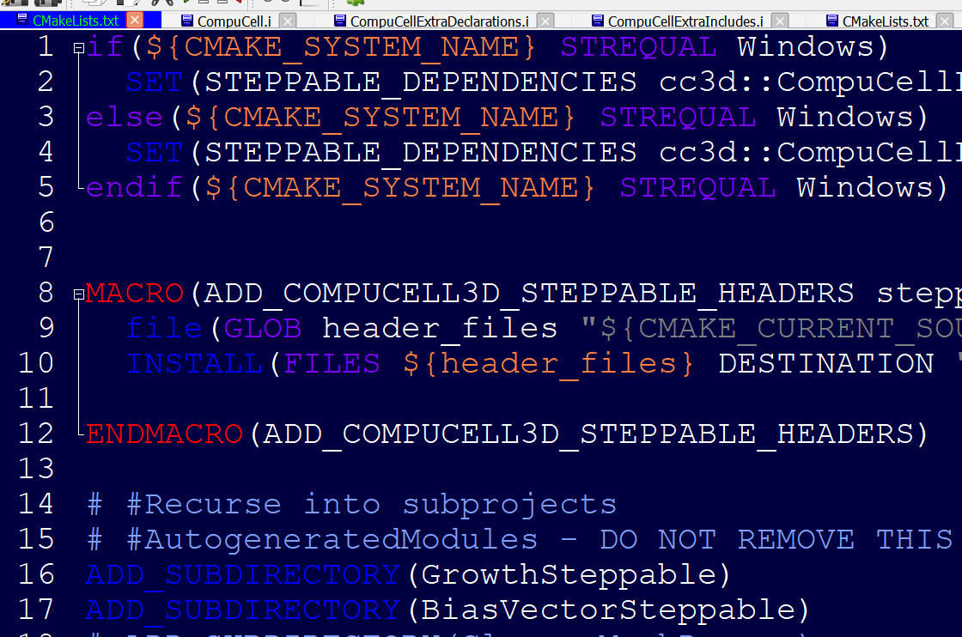
9.2.2 What is created when running
Cmake Lists is automatically updated to include your new steppable
There will be a few created, we can close these for now.
The important files to focus on first are the .cpp and the .h files

Slide 10
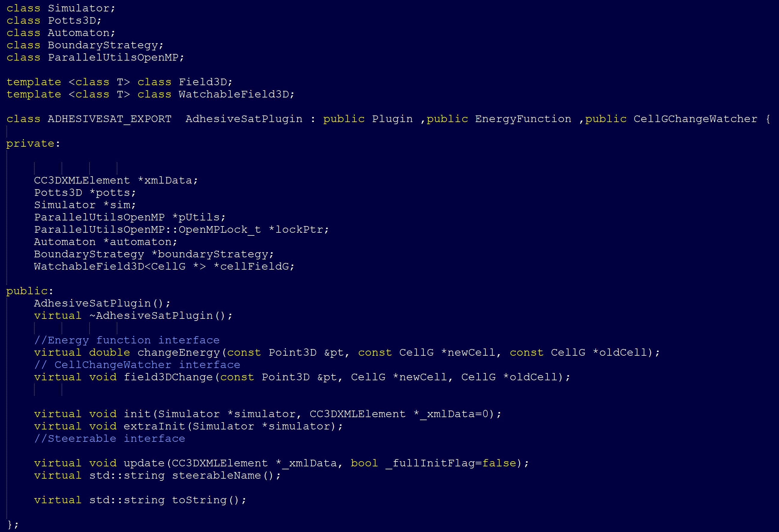
9.2.2 What is created when running: header file

Slide 11
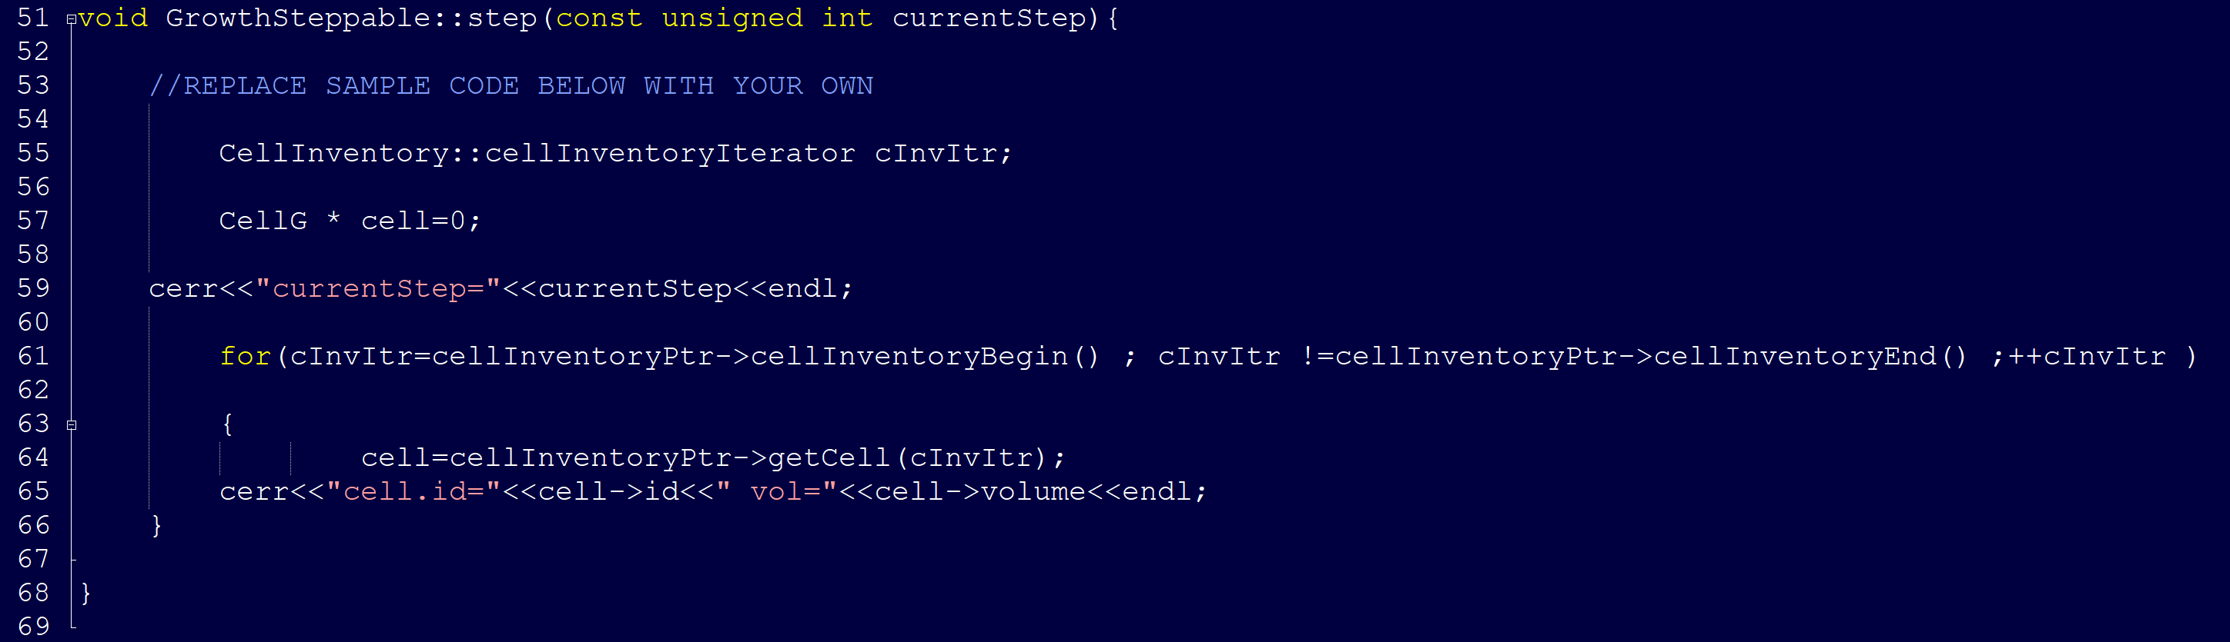
9.2.2 What is created when running: cpp file
We can define what these functions do. The cpp file comes pre-populated with some sample code:
The for loop iterates over the inventory of cells using cellInventoryPtr (a pointer to CellInventory) to print cell id and cell volume.

Slide 12
9.2.2 What is created when running: cpp file
The class for this object (CellInventory) is defined in Potts3D/CellInventory.h and implementation is in Potts3D/CellInventory.cpp. Internally, we are using STL(Standard Template Library - C++) maps to keep track of cells. The statement cellInventoryPtr->cellInventoryBegin() returns an iterator to cell inventory. If you look closely at the implementation files the container we are using as a cell inventory is std::map<CellIdentifier,CellG *> and CellIdentifier contains cell id and cluster id to uniquely identify cells. Iteration over cell inventory is simply iteration over STL map. If you are not familiar with concept of iterators and containers of STL we recommend that you look up basic C++ tutorials for example: https://www.tutorialspoint.com/cplusplus/cpp_stl_tutorial

Slide 13
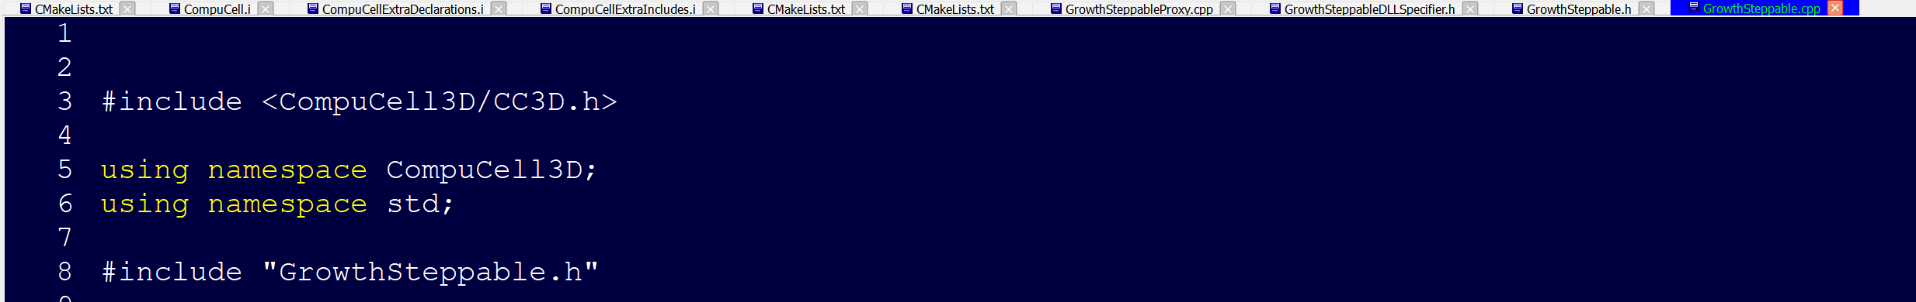
9.2.2 What is created when running
This creates 10 files that will now open in tweddit
If you see linker errors when attempting to build
You may need manually add
cc3d::GrowthStep to …\CompuCell3D\core\pyinterface\CompuCellPython\CMakeLists.txt

Slide 14
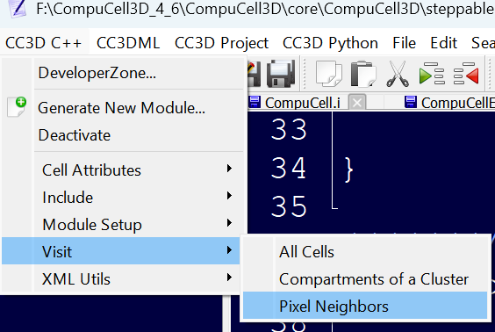
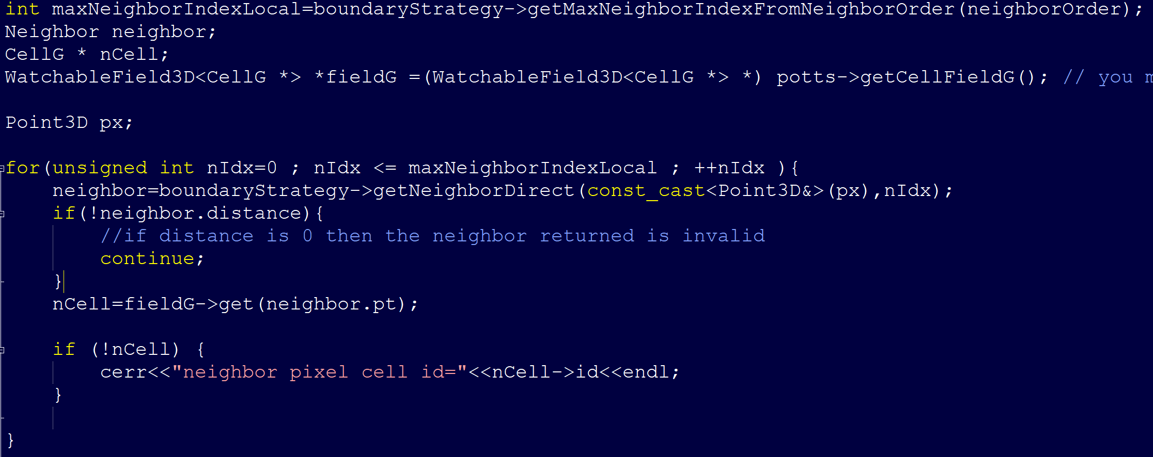
9.2.3 Tweddit shortcuts
There are a few helpful shortcuts in the Tweddit menu
For instance, if you want to visit Pixel Neighbors:

Slide 15
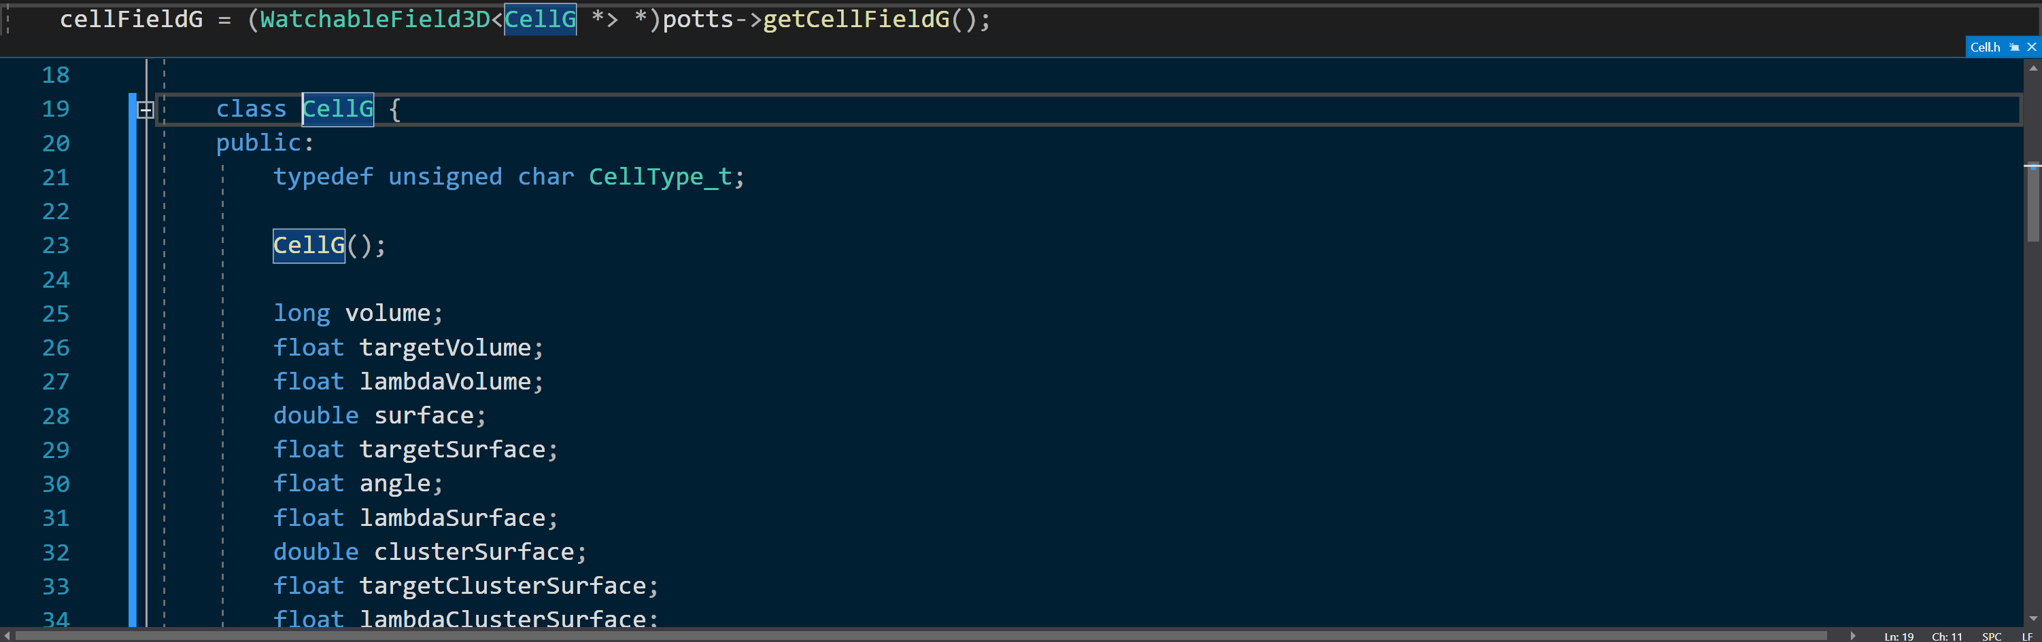
9.2.3 Using an IDE
With an IDE you can peek definitions if you need to find the reference or are curious about the object

Slide 16
9.2.3 Further comments
When working on your own steppable or plugin it is perfectly okay to hard code values at first before worrying about encoding 3D / swig / xml / mesh types

Slide 17
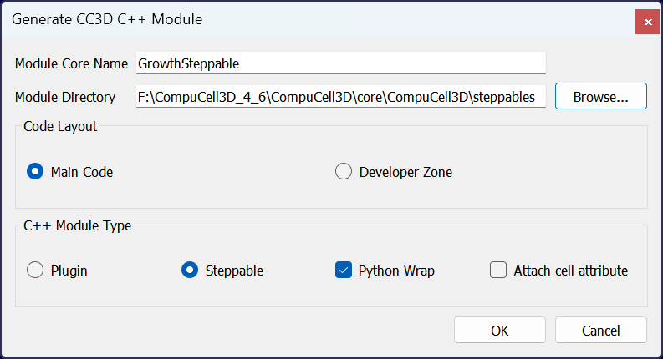
9.2.2 Let us make a steppable
Name
GrowthSteppable
target
…\CompuCell3D\CompuCell3D\core\CompuCell3D\steppables
Select Steppable
Keep Python Wrap checked

Slide 18
Exercise 9.2.4 — GrowthSteppable
Let us now try to use this information to build a GrowthSteppable in C++
First, we modify the start function to iterate over the cell inventories and assign a
target volume and lambda volume:
void GrowthSteppable::start(){
CellInventory::cellInventoryIterator cInvItr;
CellG * cell = 0;
for (cInvItr = cellInventoryPtr->cellInventoryBegin(); cInvItr != cellInventoryPtr->cellInventoryEnd(); ++cInvItr)
{
cell = cellInventoryPtr->getCell(cInvItr);
cell->targetVolume = 25.0;
cell->lambdaVolume = 2.0;
}
}

Slide 19
Exercise 9.2.4 — GrowthSteppable
We then modify the step function to modify the target volume of the cells at every mcs
at rate growthRate
void GrowthSteppable::step(const unsigned int currentStep){
CellInventory::cellInventoryIterator cInvItr;
CellG * cell=0;
float growthRate = 1.0;
for(cInvItr=cellInventoryPtr->cellInventoryBegin() ; cInvItr !=cellInventoryPtr->cellInventoryEnd() ;++cInvItr )
{
cell = cellInventoryPtr->getCell(cInvItr);
cell->targetVolume += growthRate ;
}
}

Slide 20
Exercise 9.2.4 — GrowthSteppable : Install
All_Build and INSTALL
It is important to CLOSE cc3d when installing in windows

Slide 21
Exercise 9.2.4 — GrowthSteppable : Run it!
Let us load a simple model
A single cell type around the center of the domain
(we will give two cell types for reasons that will become apparent soon)
Load GrowthSteppable, run

Slide 22
Exercise 9.2.4 — GrowthSteppable : Extending the Steppable
Now we will write a code that increases target volume of cells but only for the first 100 MCS and only if cell type is equal to 1
void GrowthSteppable::step(const unsigned int currentStep){
if (currentStep > 100)
return;
CellInventory::cellInventoryIterator cInvItr;
CellG * cell=0;
float growthRate = 1.0;
for(cInvItr=cellInventoryPtr->cellInventoryBegin() ; cInvItr !=cellInventoryPtr->cellInventoryEnd() ;++cInvItr )
{
cell = cellInventoryPtr->getCell(cInvItr);
if (cell->type == 1){
cell->targetVolume += growthRate ;
}
}
}

Slide 23
Exercise 9.2.4 — Removing hardcoded components : xml
Our aim if to have an XML definition that looks like
<Steppable Type="GrowthSteppable">
<GrowthRate>1.0</GrowthRate>
</Steppable>
void GrowthSteppable::update(CC3DXMLElement *_xmlData, bool _fullInitFlag){
automaton = potts->getAutomaton();
ASSERT_OR_THROW("CELL TYPE PLUGIN WAS NOT PROPERLY INITIALIZED YET. MAKE SURE THIS IS THE FIRST PLUGIN THAT YOU SET", automaton)
set<unsigned char> cellTypesSet;
CC3DXMLElement * growthElem = _xmlData->getFirstElement("GrowthRate");
if (growthElem){
this->growthRate = growthElem->getDouble();
}
//boundaryStrategy has information about pixel neighbors
boundaryStrategy=BoundaryStrategy::getInstance();
}

Slide 24
Exercise 9.2.4 — Removing hardcoded components : xml
We now need to define growthRate in the .h file
class GROWTHSTEPPABLE_EXPORT GrowthSteppable : public Steppable {
WatchableField3D<CellG *> *cellFieldG;
Simulator * sim;
Potts3D *potts;
CC3DXMLElement *xmlData;
Automaton *automaton;
BoundaryStrategy *boundaryStrategy;
CellInventory * cellInventoryPtr;
Dim3D fieldDim;
public:
GrowthSteppable ();
virtual ~GrowthSteppable ();
double growthRate;
...
}

Slide 25
Exercise 9.2.4 — Removing hardcoded components : xml
And modify our step function to reference the value
void GrowthSteppable::step(const unsigned int currentStep){
CellInventory::cellInventoryIterator cInvItr;
CellG * cell=0;
if (currentStep > 100)
return;
for(cInvItr=cellInventoryPtr->cellInventoryBegin() ; cInvItr !=cellInventoryPtr->cellInventoryEnd() ;++cInvItr )
{
cell=cellInventoryPtr->getCell(cInvItr);
if (cell->type == 1){
cell->targetVolume += this->growthRate;
}
}
}

Slide 26
Exercise 9.2.4 — Allowing Different Growth Rates for Different Cell types
We will need to leverage STL maps
class GROWTHSTEPPABLE_EXPORT GrowthSteppable : public Steppable {
WatchableField3D<CellG *> *cellFieldG;
Simulator * sim;
Potts3D *potts;
CC3DXMLElement *xmlData;
Automaton *automaton;
BoundaryStrategy *boundaryStrategy;
CellInventory * cellInventoryPtr;
Dim3D fieldDim;
public:
GrowthSteppable ();
virtual ~GrowthSteppable ();
std::map<unsigned int, double> growthRateMap;
...
}

Slide 27
Exercise 9.2.4 — We expect this XML structure
<Steppable Type="GrowthSteppable">
<GrowthRate CellType="1">1.3</GrowthRate>
<GrowthRate CellType="2">1.7</GrowthRate>
</Steppable>
void GrowthSteppable::update(CC3DXMLElement *_xmlData, bool _fullInitFlag){
automaton = potts->getAutomaton();
ASSERT_OR_THROW("CELL TYPE PLUGIN WAS NOT PROPERLY INITIALIZED YET. MAKE SURE THIS IS THE FIRST PLUGIN THAT YOU SET", automaton)
set<unsigned char> cellTypesSet;
CC3DXMLElementList growthVec = _xmlData->getElements("GrowthRate");
for (int i = 0; i < growthVec.size(); ++i) {
unsigned int cellType = growthVec[i]->getAttributeAsUInt("CellType");
double growthRateTmp = growthVec[i]->getDouble();
this->growthRateMap[cellType] = growthRateTmp;
}
//boundaryStrategy has information about pixel neighbors
boundaryStrategy=BoundaryStrategy::getInstance();
}

Slide 28
Exercise 9.2.4 — We then modify the step function
<Steppable Type="GrowthSteppable">
<GrowthRate CellType="1">1.3</GrowthRate>
<GrowthRate CellType="2">1.7</GrowthRate>
</Steppable>
void GrowthSteppable::step(const unsigned int currentStep){
CellInventory::cellInventoryIterator cInvItr;
CellG * cell=0;
if (currentStep > 100)
return;
std::map<unsigned int, double>::iterator mitr;
for(cInvItr=cellInventoryPtr->cellInventoryBegin() ; cInvItr !=cellInventoryPtr->cellInventoryEnd() ;++cInvItr )
{
cell=cellInventoryPtr->getCell(cInvItr);
mitr = this->growthRateMap.find((unsigned int)cell->type);
if (mitr != this->growthRateMap.end()){
cell->targetVolume += mitr->second;
}
}
}

Slide 29
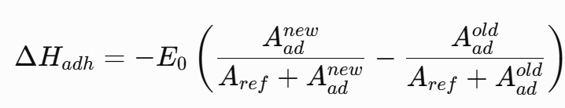
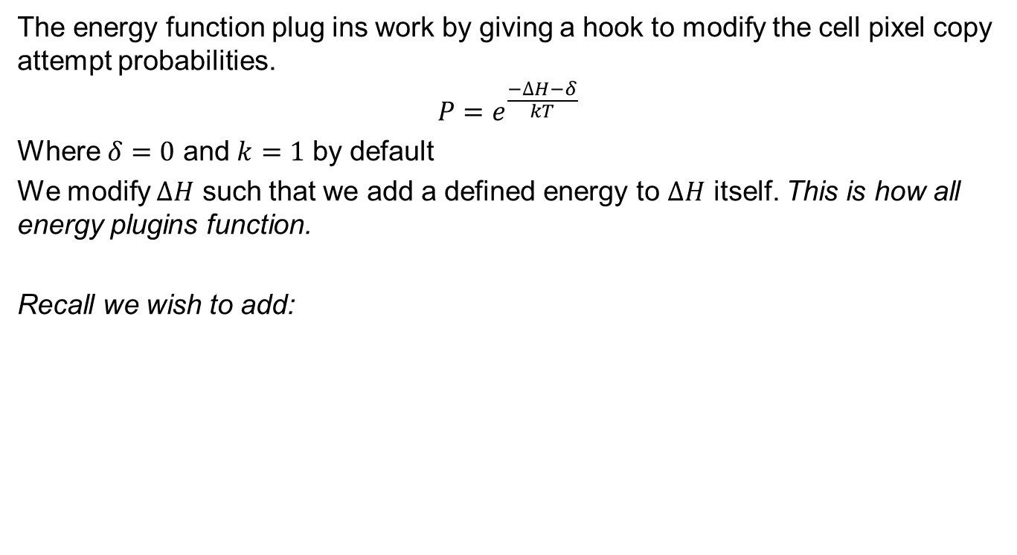
Exercise 9.2.4 — Applying an Energy Modification
The energy function plug ins work by giving a hook to modify the cell pixel copy attempt probabilities.
$$P=e^{\frac{−∆H−δ}{kT}}$$
Where $δ=0$ and $k=1$ by default
We modify $∆H$ such that we add a defined energy to $∆H$ itself. This is how all energy plugins function.
Recall we wish to add:

Slide 30
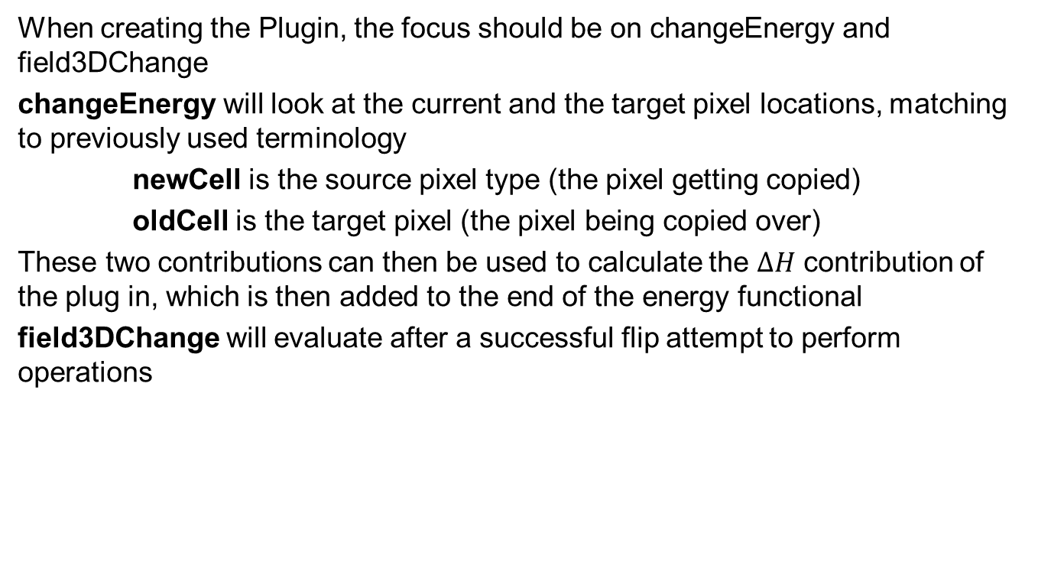
Exercise 9.2.5 — Applying our changes
When creating the Plugin, the focus should be on changeEnergy and field3DChange
changeEnergy will look at the current and the target pixel locations, matching to previously used terminology
newCell is the source pixel type (the pixel getting copied)
oldCell is the target pixel (the pixel being copied over)
These two contributions can then be used to calculate the $∆H$ contribution of the plug in, which is then added to the end of the energy functional
field3DChange will evaluate after a successful flip attempt to perform operations

Slide 31
Exercise 9.2.5: initialization
We need to know how many sites are occupied at initialization
How?
We need to update or decrease the cell object’s count depending on if the local pixel is an adhesion spot or not
Sudocode:
If Adhesion(pt)>0.5:
cell at this pt add one occupiedAdhesiveSites

Slide 32
Exercise 9.2.5: field3DChange
field3DChange evaluates after a successful flip attempts:
We need to track the number of occupied spots; how can we do this?
We need to update or decrease the cell object’s count depending on if the local pixel is an adhesion spot and if a cell is entering or leaving the space
Sudocode:
If Adhesion(pt)>0.5:
if (newCell){
add occupiedAdhesiveSites to newCell;
}
if (oldCell){
subtract occupiedAdhesiveSites from oldCell;
}

Slide 33
Exercise 9.2.5: changeEnergy
changeEnergy specifies how the Hamiltonian is modified
We need to know the current number of occupied spots then figure out how the flip will modify this value; how can we do this?
We need to calculate changes of energy dependent on the loss or gain of a site
Sudocode:
If Adhesion(pt)>0.5:
if (newCell){
new = old + 1
deltaH= -(E0*new/(A0+ new)- E0*old/(A0+ old))
}
if (oldCell){
new = old – 1
deltaH= -(E0*new/(A0+ new)- E0*old/(A0+ old))
}

Slide 34
Exercise 9.2.5 – CODE!
Let’s define our energy term to evaluate
In .h file
private:
Field3D<unsigned char>* adhesionField;
std::string adhesionFieldName;
ExtraMembersGroupAccessor<AdhesiveSatData>
adhesiveSatDataAccessor;
double E0;
double Aref;
int getOccupiedSiteCount(const CellG* cell);
double adhesionEnergy(double occupiedArea) const;
In .cpp file
double AdhesiveSatPlugin::adhesionEnergy(double occupiedArea) const {
return -E0 * occupiedArea /(Aref + occupiedArea);
}
int AdhesiveSatPlugin::getOccupiedSiteCount(const CellG* cell) {
if (!cell) {
return 0;
}
const int result =adhesiveSatDataAccessor.get(cell->extraAttribPtr)->occupiedAdhesiveSites;
return result;
}

Slide 35
Exercise 9.2.5 – CODE!
double AdhesiveSatPlugin::changeEnergy(const Point3D& pt, const CellG* newCell, const CellG* oldCell) {
if (!isAdhesiveSite(pt)) { //no point evaluating if not an adhesive site
return 0.0;
}
double deltaH = 0.0; //initialize energy
if (oldCell) {
const int oldAi =getOccupiedSiteCount(oldCell);
const int proposedAi = oldAi - 1; //old cell would lose a site
deltaH += adhesionEnergy(proposedAi) - adhesionEnergy(oldAi);
}
if (newCell) {
const int oldAi =getOccupiedSiteCount(newCell);
const int proposedAi = oldAi + 1; //new cell would gain a site
deltaH +=adhesionEnergy(proposedAi) -adhesionEnergy(oldAi);
}
return deltaH;
}

Slide 36
Exercise 9.2.5 – CODE!
void AdhesiveSatPlugin::field3DChange(const Point3D& pt,CellG* newCell,CellG* oldCell) {
if (!isAdhesiveSite(pt)) { //no point evaluating if not an adhesive site
return;
}
if (oldCell) {
AdhesiveSatData* oldData =adhesiveSatDataAccessor.get(
oldCell->extraAttribPtr);
--oldData->occupiedAdhesiveSites; //old cell loses a site
}
if (newCell) {
AdhesiveSatData* newData =adhesiveSatDataAccessor.get(
newCell->extraAttribPtr);
++newData->occupiedAdhesiveSites; //new cell gains a site
}
}

Slide 37
Exercise 9.2.5 – Initialization and XML definitions
We are now forced to do a few extra operations to get this code to work
We need to define the field, for now we will define it in the init:
void AdhesiveSatPlugin::extraInit(Simulator* simulator) {
initializeYField();
//this function creates a 200x200 lattice forming a Y with thickness 7
initializeOccupiedSiteCounts();
//this function initializes the number of lattice sites already occupied by cells
}
Both are written in the .cpp file and defined in the .h
XML definitions and relationships are typically contained within the update function

Slide 38
Final comments
If you want to contribute your plug in to release CC3D you are welcome to, but it will need to be extensible meaning:
Error checking
Method should work in square and hex lattice types, all copy ranges and in 2D/3D
Should have CC3DML counterpart and be Python controllable
Documentation with clear explanation of purpose and function at the mathematical level
Include method demos
For simple plug in examples or examples of a c++ steppable see: https://compucell3ddevelopersmanual.readthedocs.io/en/master/building_growth_steppable_in_main_code.html#

Slide 39


Module Questionnaire
Please take a minute or two to let us know about your experience with this module by filling out the brief zoom survey
Feel free to provide additional comments and suggestions in the slack or by email to us as well (hfennel@iu.edu)
Funding: NIH U24 EB028887, NSF 2120200, NSF 2000281, NSF 1720625
Previous Funding: NIH R01 GM12242439

